Slide 1
Computer Architecture (CS-211)
Recitation 1
Song Wen

Slide 2


CS 211 Computer Architecture
TA Information
Name : Song Wen
Email : song.wen@rutgers.edu
If you need to send an e-mail, please use [CS-211] as prefix in your Email Subject!
Section 06 Recitation: Tuesday 9:00 AM - 9:55 AM Section 07 Recitation: Wednesday 9:00 PM - 9:55 PM
Office Hours : Tuesday 10:30 AM – 11:30 AM
https://rutgers.webex.com/meet/sw978
2

Slide 3
CS 211 Computer Architecture
Topics
Introduction
How to use iLab machines
Useful Linux Commands
How to write and compile C programs
* Some materials are collected and compiled from previous year's CS 211 lectures and TAs
3

Slide 4
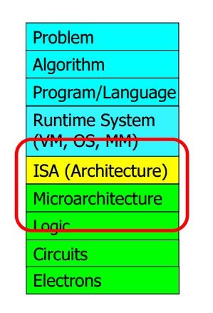
CS 211 Computer Architecture
Introduction
Source : Computer Architecture by Onur Mutlu from Carnegie Melon University
4

Slide 5
CS 211 Computer Architecture
How to use iLab Machine
Follow the link to open your account
http://www.cs.rutgers.edu/resources/systems/ilab/
To get connected with iLab machines
Download and install X2GO client for GUI
Download and install Putty/WinSCP on Windows
Use Terminal/Command Line application on Linux
$ ssh netid@address
eg. ssh song@builder.cs.rutgers.edu
You can also download and install MobaXterm on Windows for as command line application.
5

Slide 6
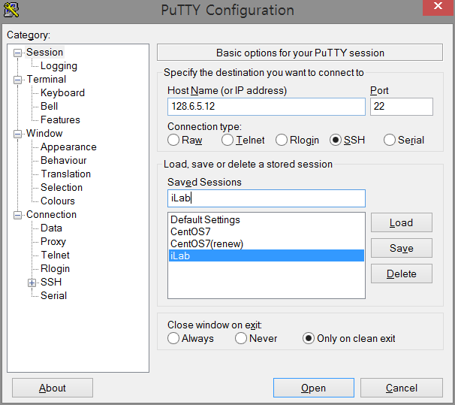
CS 211 Computer Architecture
How to use iLab Machine (Windows - Putty)
Put the IP address of the machine in iLab (the IP address may be different as it is shown) or iLab machine name
Save the session
Connect iLab Machine
6

Slide 7
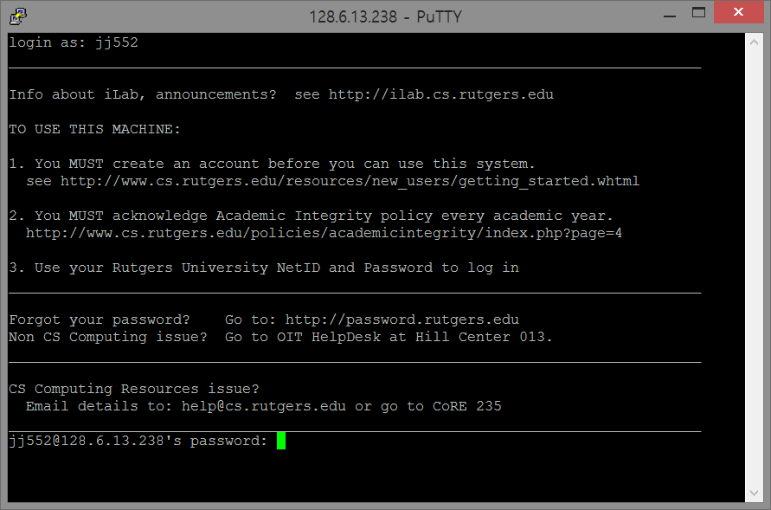
CS 211 Computer Architecture
How to use iLab Machine (Windows - Putty)
Login with your netID
7

Slide 8
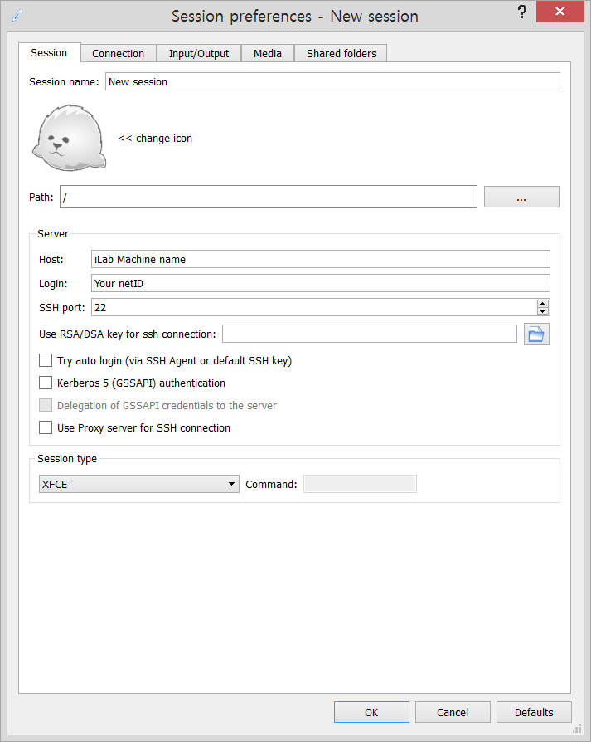
CS 211 Computer Architecture
How to use iLab Machine (Using X2go)
Put any iLab machine name
Your netID
Select one of XFCE, MATE, KDE
8

Slide 9
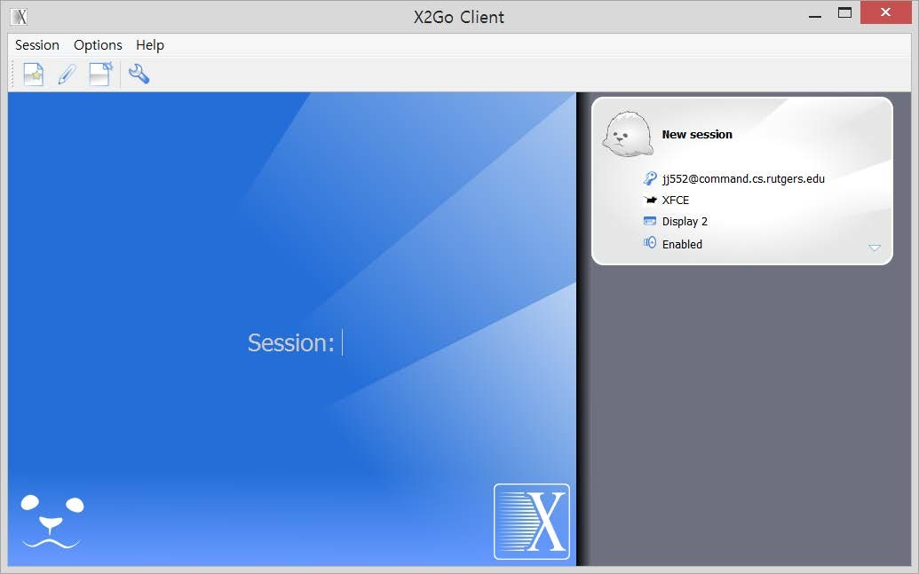
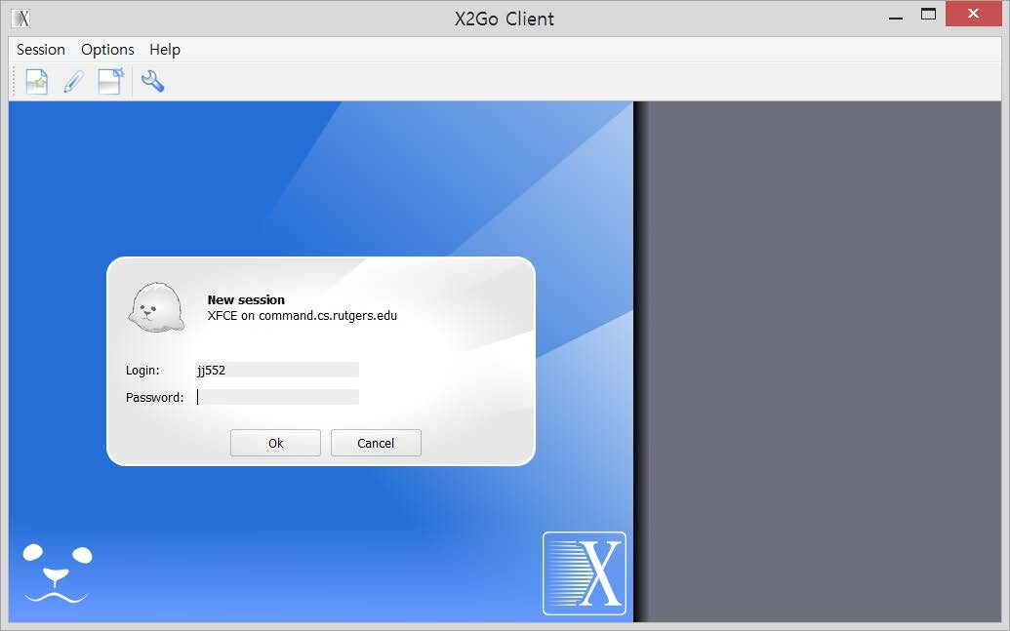
CS 211 Computer Architecture
How to use iLab Machine (Using X2go)
9

Slide 10
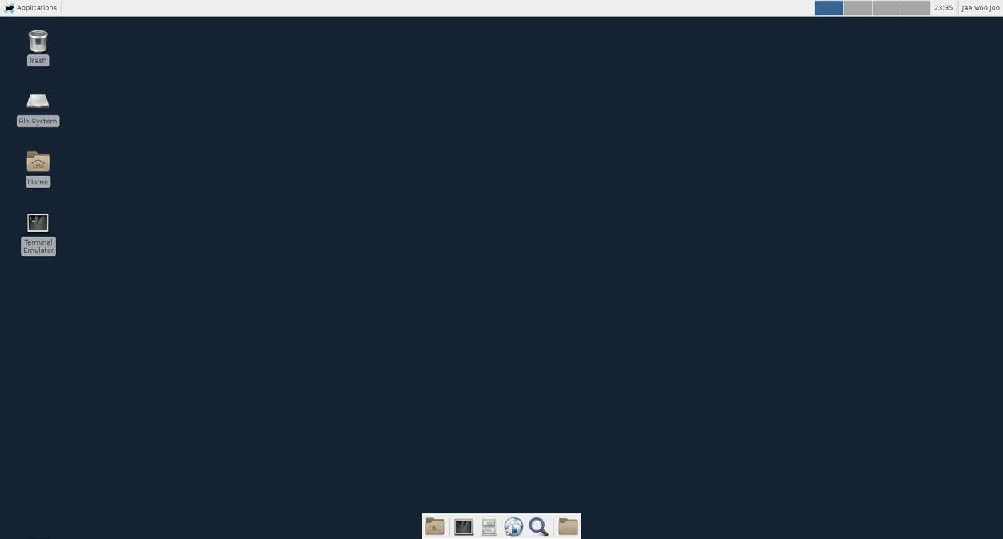
CS 211 Computer Architecture
How to use iLab Machine (Using X2go)
You are connected to iLab machine
10

Slide 11
CS 211 Computer Architecture
Basic Linux Commands 1
Check out this: http://linuxcommand.org/index.php
ssh: login to any machines remotely
pwd: show current location
cd: change directory (eg. $cd Documents, or $ cd ..)
ls: list all contents (check http://www.rapidtables.com/code/linux/ls.htm)
locate: show location of a file (eg. $locate test.txt)
grep: search texts in files (e.g. $ grep “cs 211” *.txt) (check http://www.cyberciti.biz/faq/howto-use-grep-command-in-linux-unix/)
version: show version (eg. $ java -version)
cat: print contents on screen (ex. $ cat test.txt)
touch: create a file (eg. $ touch test.txt)
nano, vim: editor (eg. $ nano test.txt)
11

Slide 12
CS 211 Computer Architecture
Basic Linux Commands 2
cp: copy file (eg. $ cp source.txt destination.txt)
mkdir: make directory (eg. $ mkdir myfolder)
rm: remove file (eg. $ rm test.txt)
mv: rename file (eg. $ mv oldname.txt newname.txt)
scp: transfer file from local to server machine and vice versa ( $ scp source destination)
Local computer to iLab
$ scp -r local-folder/ netid@ilab4.cs.rutgers.edu:~/
iLab to Local (execute command from local machine)
$ scp -r netid@ilab4.cs.rutgers.edu:~/remote-folder/ /home/
12

Slide 13
CS 211 Computer Architecture
Basic commands in Vi / Vim
Switch between Edit and Command mode
Open file $ vi myfile.txt
Hit i to insert text
Esc to switches back to command mode
Basic operations (in command mode)
w : will save (write) the file
q : will exit the editor
q! : forces to quit a file containing unsaved changes
wq : will save and exit
13

Slide 14
CS 211 Computer Architecture
How to compile C in Linux
GCC
GNU Compiler Collection
gcc is a compiler that can compile C, C++, JAVA, FORTRAN, …
Most widely used for compiling program
We use gcc to compile C in Linux
Create a .c file (eg. $ touch hello.c)
Open the file with gedit/vim/nano
Compile your code $ gcc -Wall -Werror -fsanitize=address hello.c -o hello
Run your code $ ./hello
Werror: Make all warnings to errors
Wall: Show all warnings
Fsanitize=address: a fast memory error detector
14

Slide 15
CS 211 Computer Architecture
Sample C Program
#include <stdio.h>
int main() {
int integer;
float num;
char str[100];
printf("Enter an integer: ");
scanf("%d", &integer);
printf("Enter a floating number: ");
scanf("%f", &num);
printf("Enter a string: ");
scanf("%s", str);
printf("Integer %d \nFloat %f \nString %s \n", integer, num, str);
return 0;
}
Result
Enter an integer: 211
Enter a floating number: 4.5 Enter a string: Hello world!
Output
Integer 211
Float 4.5
String Hello World!
15

Slide 16
CS 211 Computer Architecture
Q&A
Thanks!
16

